Slide 1





AJAX and jQuery AJAX
AJAX Concepts, jQuery AJAX: $.ajax(), $.get(), $.post()
JavaScript for Front-End
XMLHttpRequest
SoftUni Team
Technical Trainers
Software University
http://softuni.bg

Slide 2


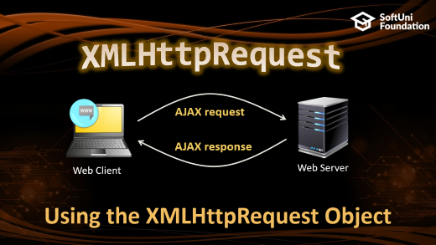



Table of Contents

Slide 3
Have a Question?
sli.do #front-end

Slide 4

What is AJAX?
AJAX == Asynchronous JavaScript And XML
Technique for background loading of dynamic content / data
Web pages / apps load data from the Web server and render it
Two types of AJAX
Partial page rendering
Load HTML fragment + show it in a <div>
JSON service
Load JSON object and display it with JavaScript / jQuery

Slide 5




AJAX: Workflow
1. HTTP request (initial page load)
2. HTTP response (HTML page)
AJAX request
UI Interaction
AJAX response (asynchronous)
AJAX handler
Returns data as JSON / HTML
Web Client
Web Server
Modify the page DOM

Slide 6
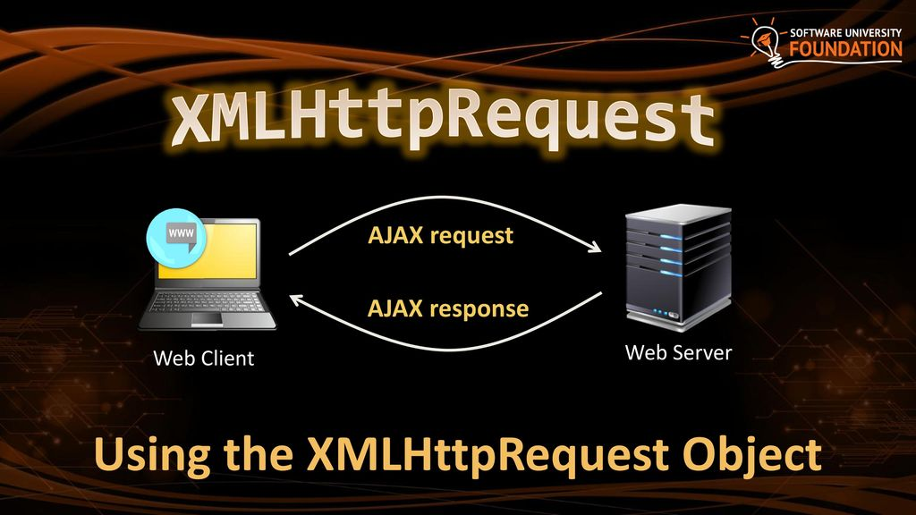

Slide 7
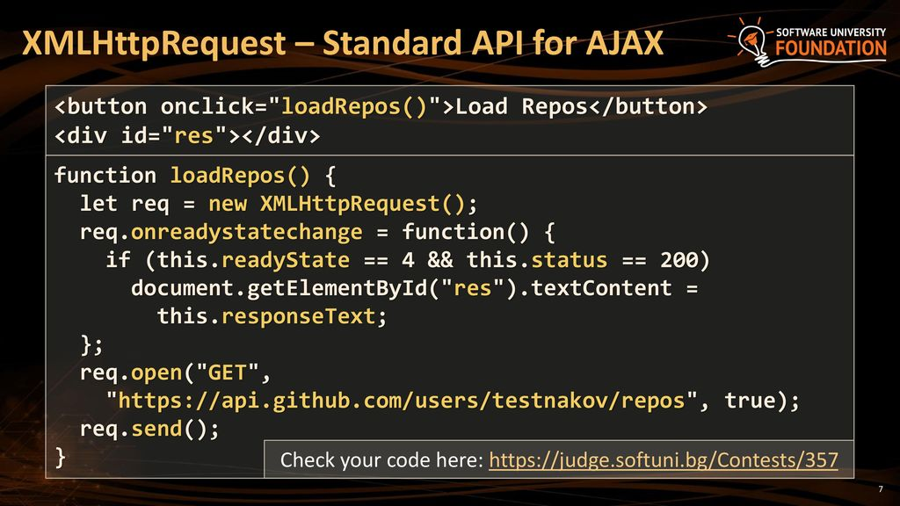

Slide 8
jQuery AJAX
Simplified AJAX Calls with jQuery

Slide 9
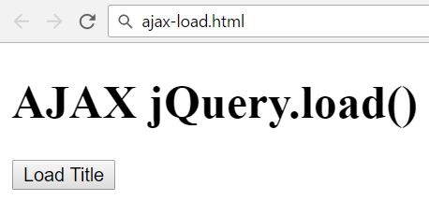
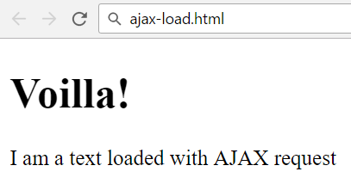
jQuery AJAX
jQuery dramatically simplifies how developer make AJAX calls
Problem: create a page holding a button
Clicking the button should load a html fragment and display it inside a div

Slide 10
Solution: jQuery.load()
ajax-load.html
<div id="text">
<h1>AJAX jQuery.load()</h1>
<button onclick="loadTitle()">Load Title</button>
</div>
ajax-load.js
text.html
function loadTitle() {
$('#text').load("text.html");
}
<h1>Voilla!</h1>
<p>I am a text loaded with AJAX request</p>

Slide 11
Handling Errors
Uses a special HTTP header:
Access-Control-Allow-Origin
Scripts can execute AJAX requests
Either to their origin (same-origin policy)
Or when the remote server explicitly allows AJAX calls via CORS
$(document).ajaxError(function(event, req, settings) {
$('#text').text(`Error loading data: ${req.status}
(${req.statusText})`);
});
function loadTitle() {
$('#text').load("http://dir.bg");
}
This cross-origin AJAX request will fail due to missing CORS headers

Slide 12
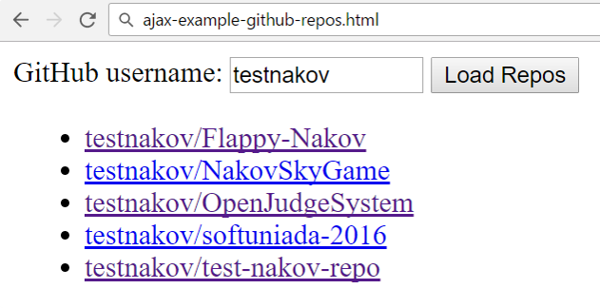
Problem: Load GitHub Repos with AJAX
GitHub username:
<input type="text" id="username" value="testnakov" />
<button onclick="loadRepos()">Load Repos</button>
<ul id="repos"></ul>
<script>
function loadRepos() {
// AJAX call …
}
</script>

Slide 13
Solution: Load GitHub Repos with AJAX
function loadRepos() {
$("#repos").empty();
let url = "https://api.github.com/users/" +
$("#username").val() + "/repos";
$.ajax({ url,
success: displayRepos,
error: displayError
});
function displayRepos(respos) { … }
function displayError(err) { … }
}

Slide 14
Solution: Load GitHub Repos with AJAX (2)
function displayRepos(respos) {
for (let repo of respos) {
let link = $('<a>').text(repo.full_name);
link.attr('href', repo.html_url);
$("#repos").append($('<li>').append(link));
}
}
function displayError(err) {
$("#repos").append($("<li>Error</li>"));
}
Check your solution here: https://judge.softuni.bg/Contests/357

Slide 15

Firebase
Mobile Back-End as a Service

Slide 16




Introduction to Firebase
A web application always has a Front-End part and a Back-End part.
Each side may be simulated depending on the application.
MBaaS helps simulate the Back-End part of an application.
Offers a back-end platform which you can consume.
Offers a data storage service.
Offers implemented functionality and security.

Slide 17

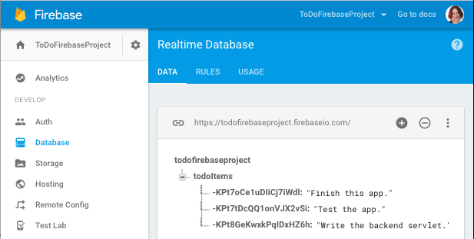
Introduction to Firebase
Firebase is a mobile and web application development platform.
Offers many services that make application development smooth and easy:
Analytics
Cloud Messaging
Authorization
Database & Storage
Hosting

Slide 18

Firebase
Demo. Firebase Playground

Slide 19
AJAX - Examples
Using jQuery to Access REST APIs

Slide 20
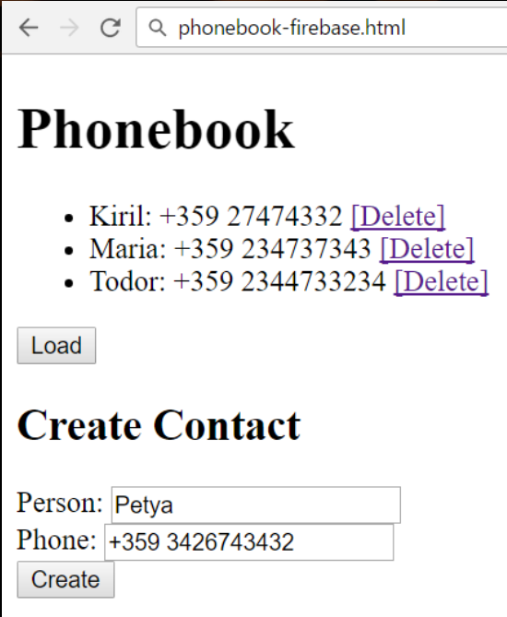
Problem: Phonebook App in Firebase
Create a mini phonebook JS front-end app
Hold your data in Firebase
Disable the authentication to simplify your work
Implement "list phones", "add phone", "delete phone"

Slide 21
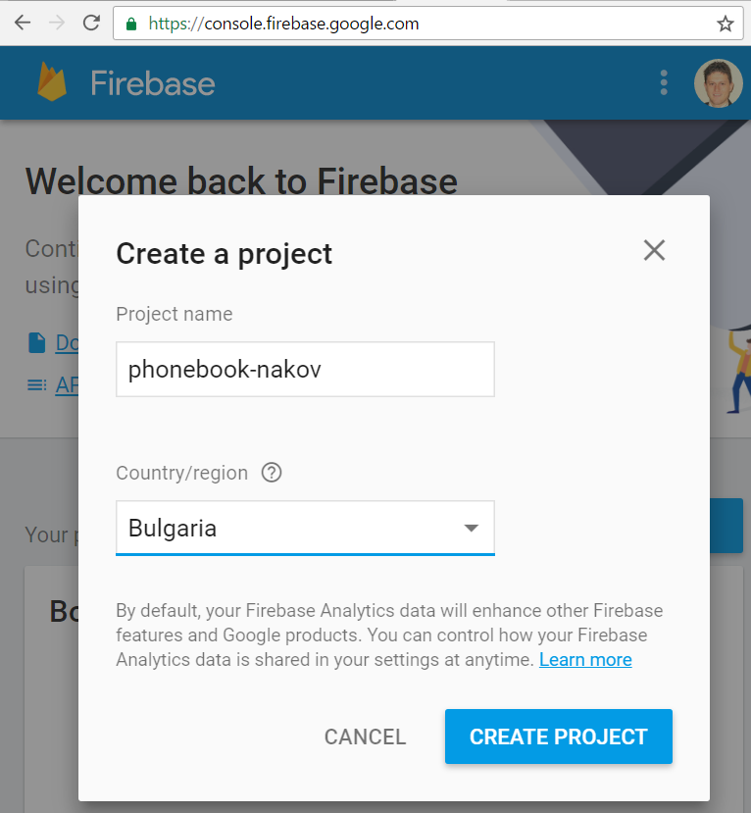
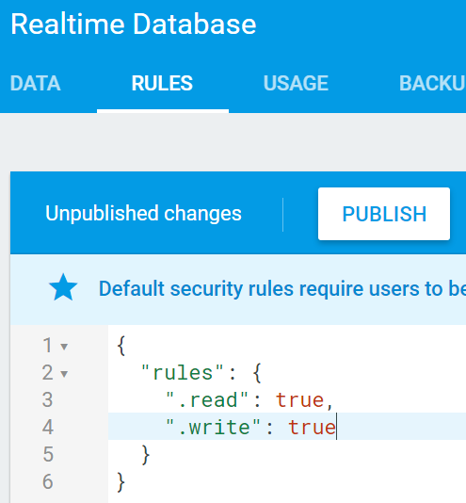
Solution: Setup a Firebase DB
Open https://console.firebase.google.com/
Create a new project
Enable public read / write access

Slide 22
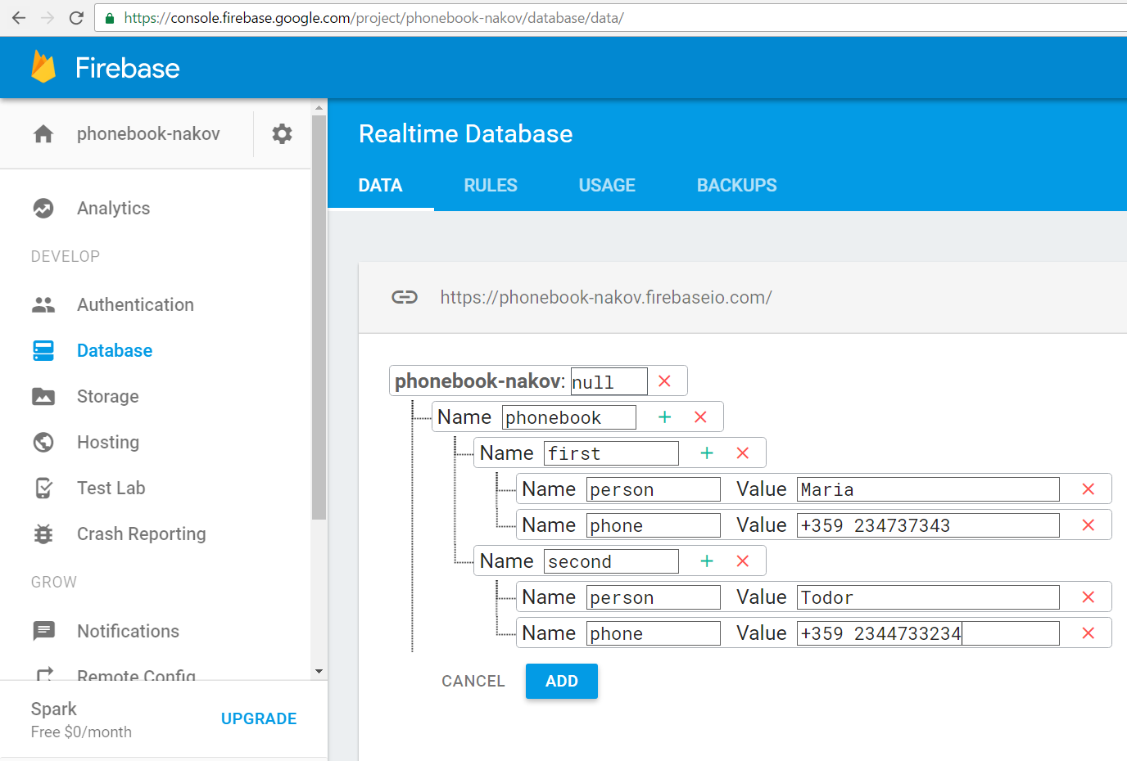
Solution: Add Sample Data in Firebase

Slide 23
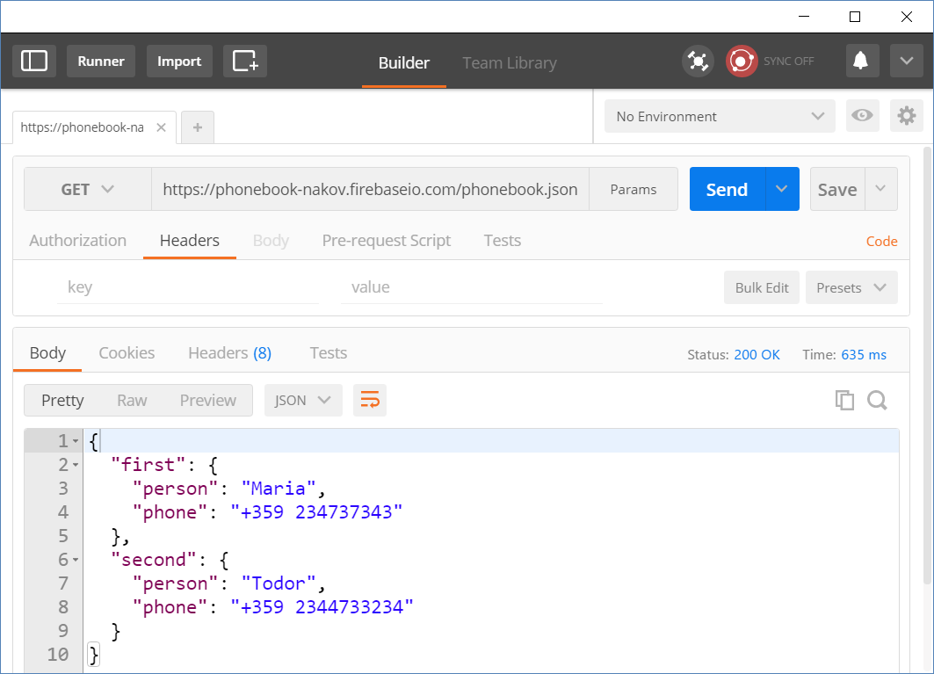
Solution: Test Your REST Service

Slide 24
Solution: Phonebook in Firebase – HTML
<h1>Phonebook</h1>
<ul id="phonebook"></ul>
<button id="btnLoad">Load</button>
<h2>Create Contact</h2>
Person: <input type="text" id="person" />
<br>
Phone: <input type="text" id="phone" />
<br>
<button id="btnCreate">Create</button>

Slide 25
Solution: Phonebook in Firebase – JS Core
$(function () {
$('#btnLoad').click(loadContacts);
$('#btnCreate').click(createContact);
let baseServiceUrl =
'https://phonebook-nakov.firebaseio.com/phonebook’;
function loadContacts() { … }
function displayContacts(contacts) { … }
function displayError(err) { … }
function createContact() { … }
function deleteContact(key) { … }
});

Slide 26
Solution: Phonebook in Firebase – JS Core
function loadContacts() {
$("#phonebook").empty();
$.get(baseServiceUrl + '.json’)
.then(displayContacts)
.catch(displayError);
}
function displayError(err) {
$("#phonebook").append($("<li>Error</li>"));
}

Slide 27
Solution: Phonebook in Firebase – JS Core
function displayContacts(contacts) {
for (let key in contacts) {
let person = contacts[key]['person’];
let phone = contacts[key]['phone’];
let li = $("<li>");
li.text(person + ': ' + phone + ' ‘);
$("#phonebook").append(li);
li.append($("<button>Delete</button>")
.click(deleteContact.bind(this, key)));
}
}
Bind the event handler with the current key

Slide 28
Solution: Phonebook in Firebase – JS Core
function createContact() {
let newContactJSON = JSON.stringify({
person: $('#person').val(),
phone: $('#phone').val()
});
$.post(baseServiceUrl + '.json', newContactJSON)
.then(loadContacts)
.catch(displayError);
$('#person').val(‘’);
$('#phone').val('');
}

Slide 29
Solution: Phonebook in Firebase – JS Core
The correct contact key
will come as parameter
(due to binding)
function deleteContact(key) {
let request = {
method: 'DELETE',
url: baseServiceUrl + '/' + key + '.json’
};
$.ajax(request)
.then(loadContacts)
.catch(displayError);
}
Check your solution here: https://judge.softuni.bg/Contests/357

Slide 30



Summary
AJAX sends asynchronous HTTP requests from JS
jQuery simplifies how developers use AJAX
$.ajax({ url, method: 'GET',
success: displayRepos,
error: displayError
});
function displayRepos(respos) { … }
function displayError(err) { … }
}

Slide 31







JavaScript for Front-End – AJAX Intro
https://softuni.bg/courses/javascript-for-front-end

Slide 32
License
This course (slides, examples, demos, videos, homework, etc.) is licensed under the "Creative Commons Attribution-NonCommercial-ShareAlike 4.0 International" license

Slide 33





Trainings @ Software University (SoftUni)
Software University – High-Quality Education, Profession and Job for Software Developers
softuni.bg
Software University Foundation
http://softuni.foundation/
Software University @ Facebook
facebook.com/SoftwareUniversity
Software University Forums
forum.softuni.bg

